Slide 1
TECHNICAL ANALYSIS SCREENER_1 MOVING AVERAGES
By
Group -7

Slide 2

Group Members
Badagouni Laxmi Prasanna
Gorige Kavya
Jillellamudi Meghana
Bothsa Snehitha
Sri Pooja Hruthi

Slide 3
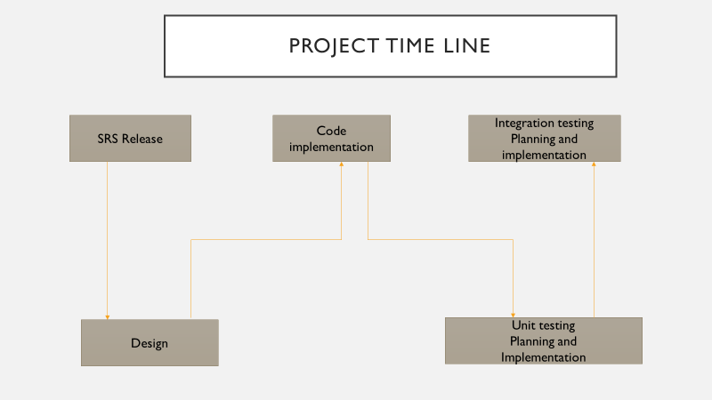
SRS Release
Code Implementation
Integratation Testing
Planning
Implementation
Design
Valgrind
Splint

Slide 4
Agenda
1. Understanding the Problem Statement
2. HLD, LLD
3.Coding and execution
4. Coding and Testing
5.Conclusion

Slide 5
What is Technical Analysis Screener?
Technical Analysis is a trading discipline employed to evaluate investments and identify trading opportunities by analysing statistical trends gathered from trading activity such as price movement and volume.
Technical Stock Screeners allow us to filter stock account to many of the same price dependent technical indicators that we would use on a stock chart.
Technical Screeners can be extremely valuable for traders.

Slide 6

2.
Coding And Execution
1.Uderstanding the Problem Statement

Slide 7
Understanding the Problem Statement
Add and update stocks to a configuration file and other console based
Update, append, remove and display stocks to a configure file
Addition/modification/deletion of functionality upto 20 stocks
Analysing the algorithm using Moving Averages
Recommendations -- buy/sell based on algorithm

Slide 8
2.
Coding And Execution
2.HLD, LLD

Slide 9
Low Level Design:

Slide 10
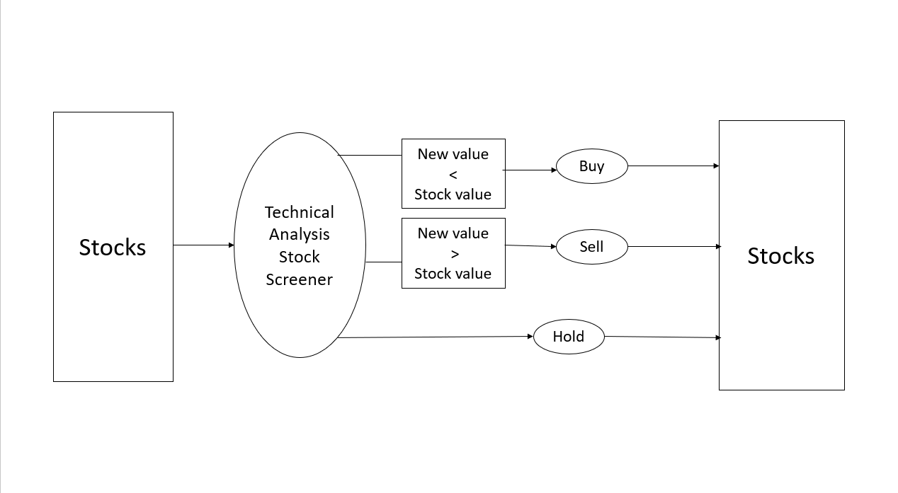
High Level Design:

Slide 11
Flowchart

Slide 12
Simple Moving Average:
A simple moving average calculates the average of range of prices by the number of periods within that range.
A simple moving average is a technical indicator that can aid in determining if a stock price will continue or if it will reverse a bull or bear trend.
It is calculated by adding recent prices and then dividing that figure by the number of time periods in the calculation average.

Slide 13
Exponential Moving Average:
An exponential moving average is a type of moving average that places a greater weight and significance on the most recent data points.
An exponentially weighted moving average reacts more significantly to recent price changes than a simple moving average.
Like all moving averages this technical indicator is used to produce buy and sell signals based on crossovers and divergences from the historical average.

Slide 14
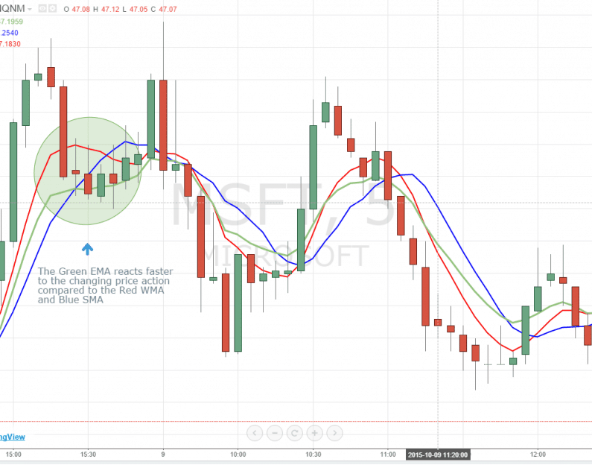
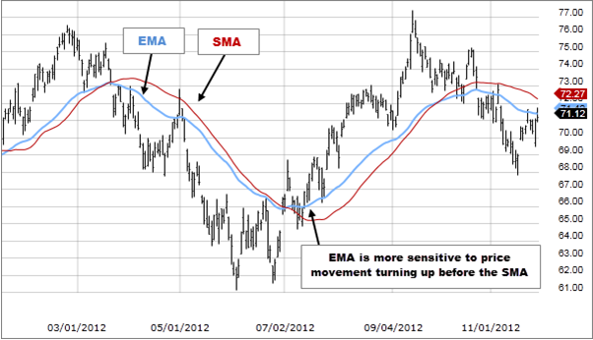
Growth by sector graph:

Slide 15
System Architecture:
Start
Menu
User
Create
Stock details
Such as stock id,
Stock name, stock open,
Stock high, stock low and stock volume
Append and Update
Stock details upto 20 stocks
And display
Analysing the algorithm based on moving averages
Recommend to buy /sell of stocks based on algorithm

Slide 16
2.
Coding And Execution
3.Coding and Executing

Slide 17
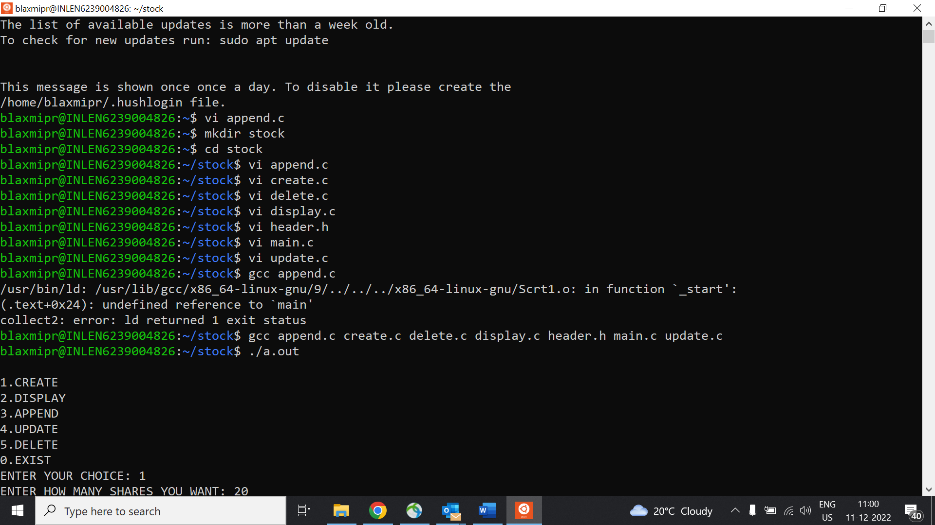

Slide 18
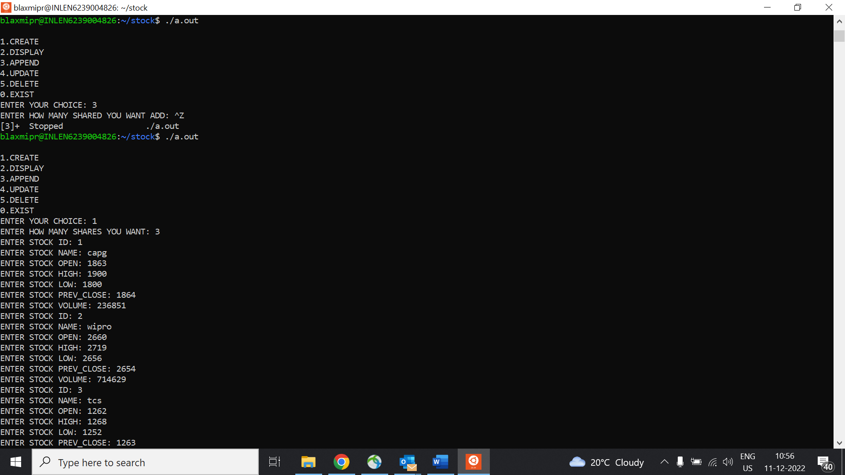

Slide 19
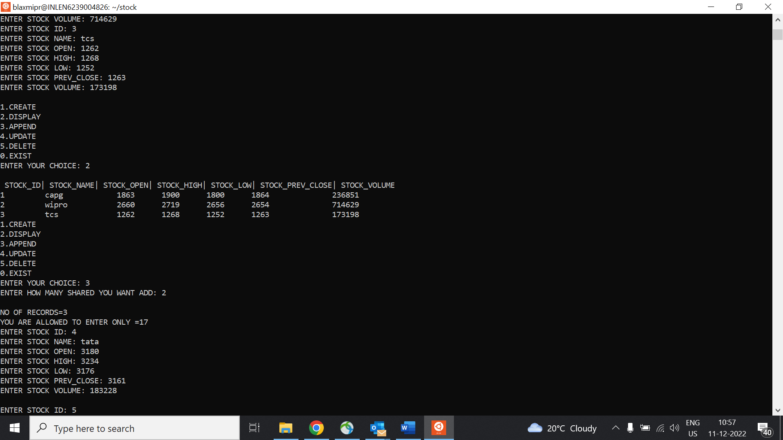

Slide 20
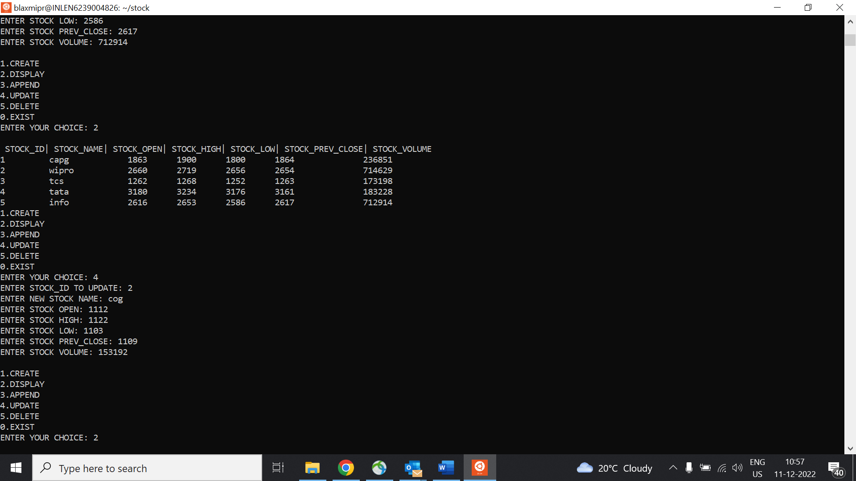

Slide 21
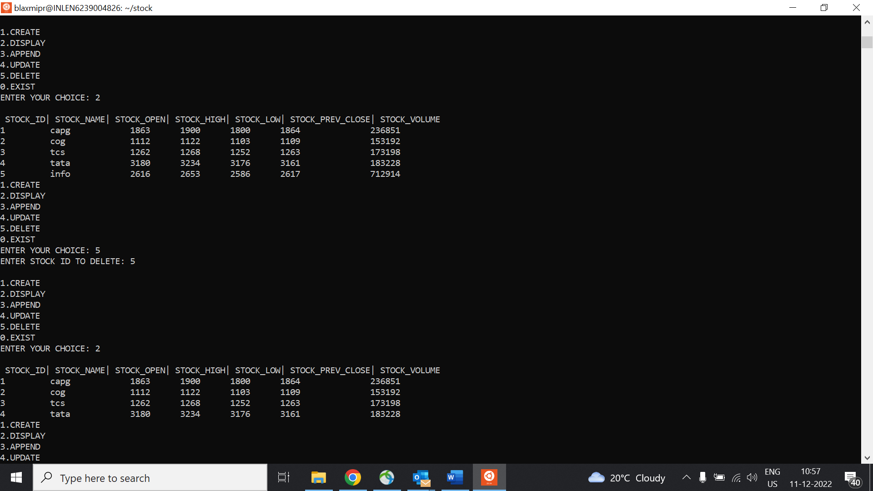

Slide 22
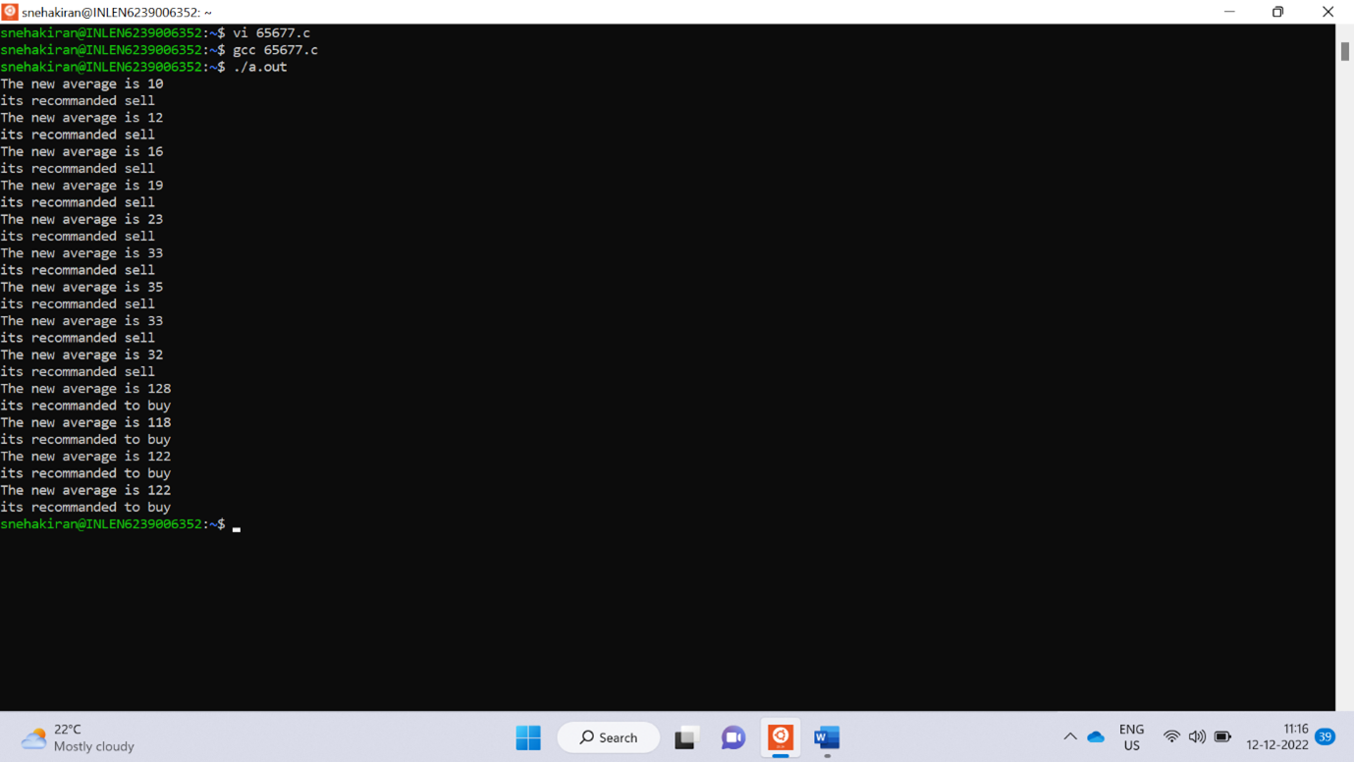

Slide 23
2.
Coding And Execution
4.Coding and Testing

Slide 24
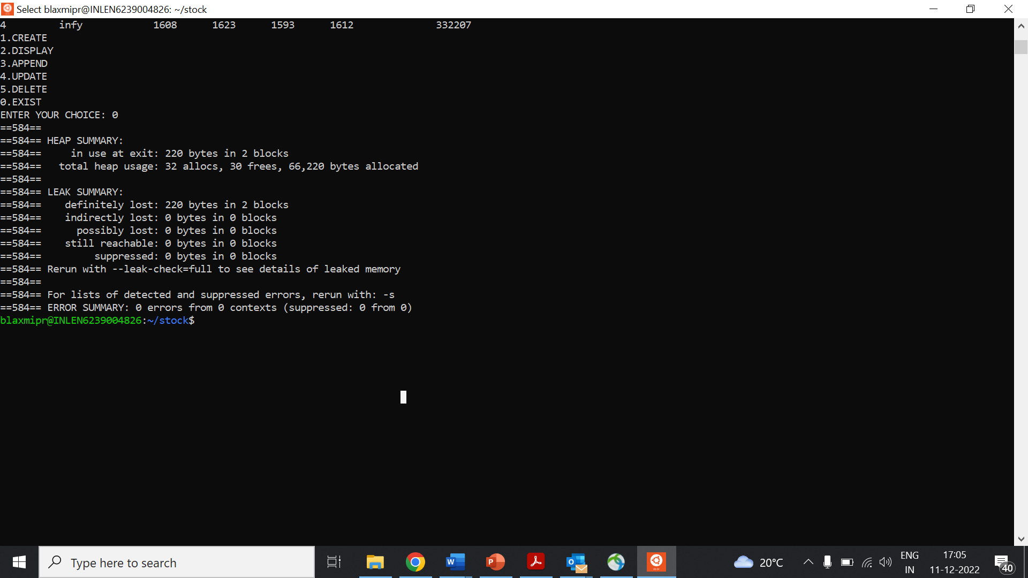
gValgrind Tool:

Slide 25
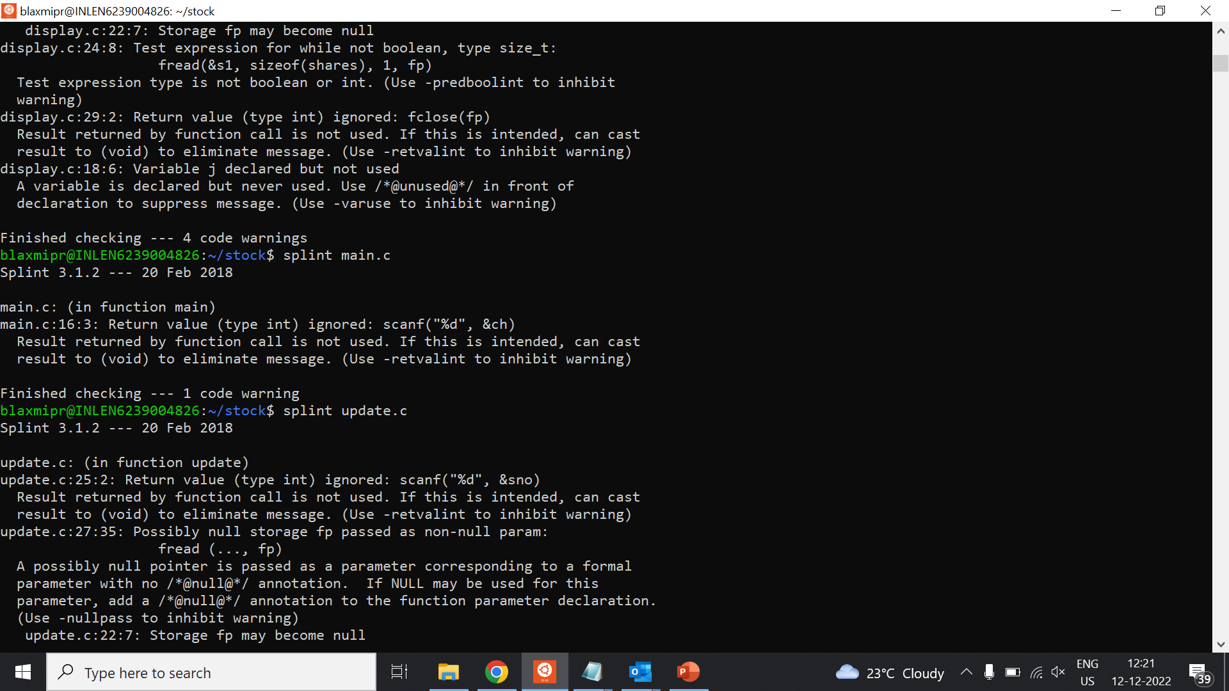
Splint Tool:

Slide 26
Conclusion:
Successfully completed the coding and testing phases as per the given problem statement.
In this project stock details are created and operations are performed.
With the help of technical analysis screener, people are recommended to buy/sell stocks using algorithm of moving averages.

Slide 27

Thank you

Slide 28

Github link:http
s://github.com/blaxmiprasannical-Analysis-Screener_1--Moving-https://github.com/blaxmiprasanna16/Technical-Analysis-Screener_1--Moving-Averages/tree/main/Tecnical%20Analysis%20Screener_1Averages/tree/main/Tecnical%20Analysis%20Screener_1

